Slide 2
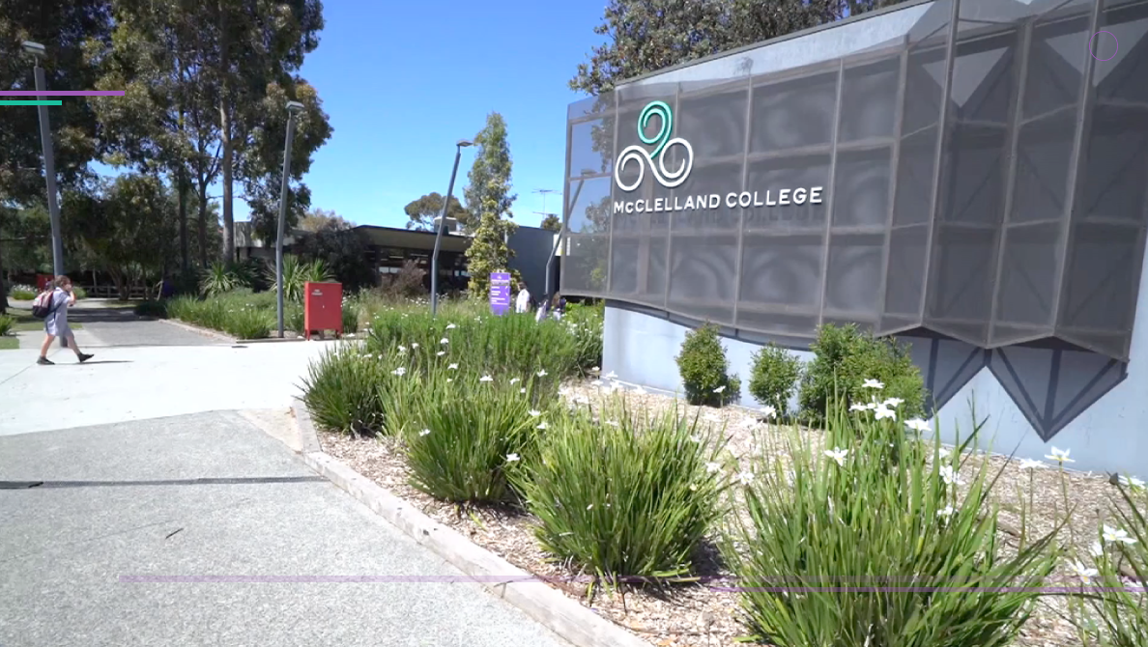
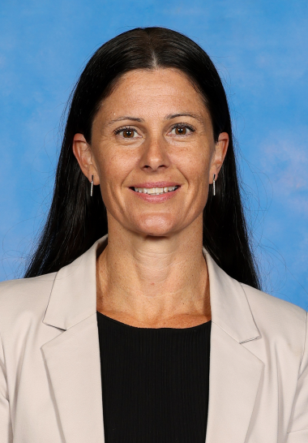
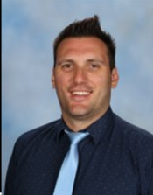
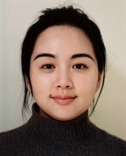
Meet Our International Team
College Principal
Director
International Program
International
Co-ordinator
International
Co-ordinator
Laura Dowdell Spence
Andrew Hemsley
Chenhao Cui
Ming Liu

Slide 3
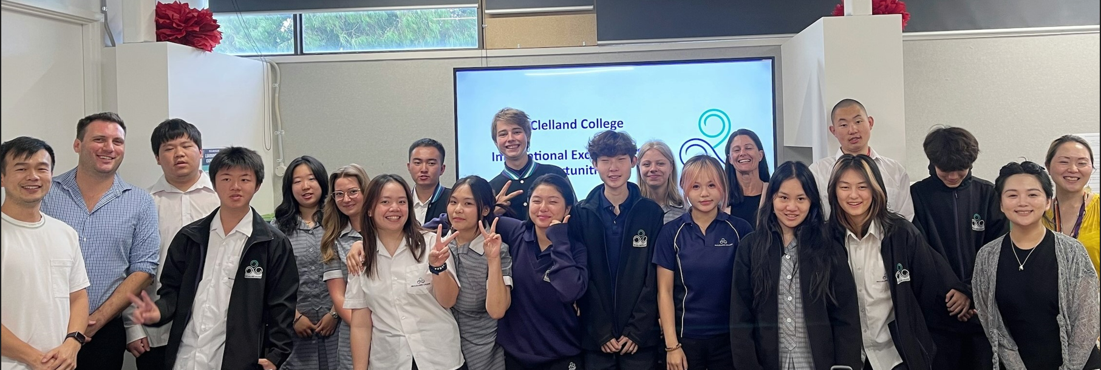
Meet Our International Students

Slide 4
Location
McClelland College is situated in a beachside suburb with vibrant shopping and restaurant options on the doorstep and excellent transport links to the city centre. The Australian lifestyle: sun, surf and nature’s beauty is part of the package when you study at McClelland College.

Slide 7
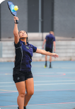
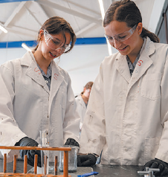
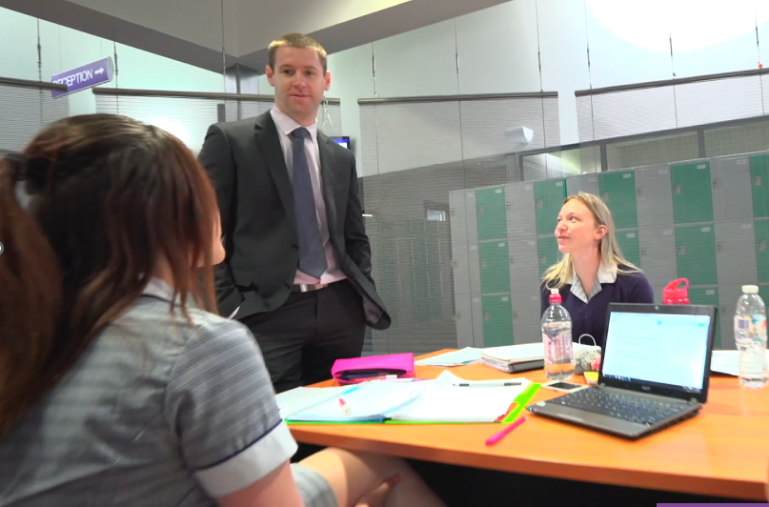
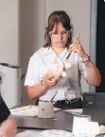
McClelland Academy Program
Our MAP is a unique whole-school program designed around our student’s PASSION.
Passion
Pathway
Success

Slide 8
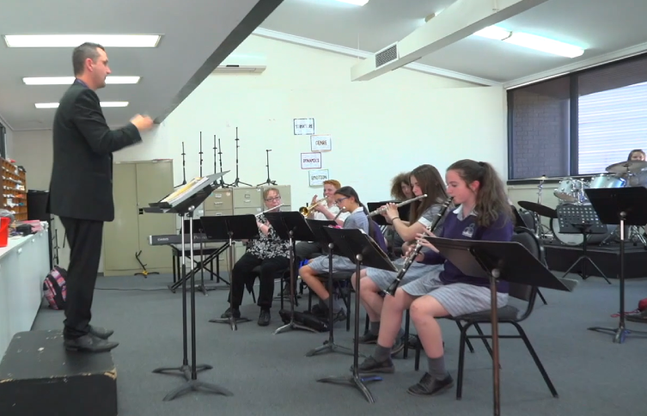
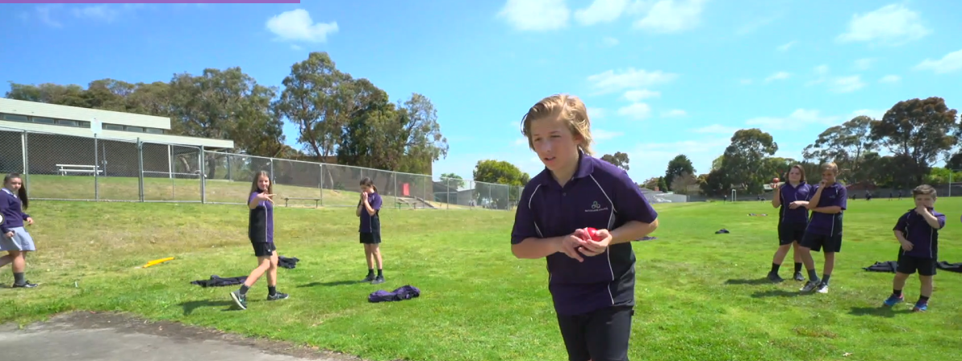
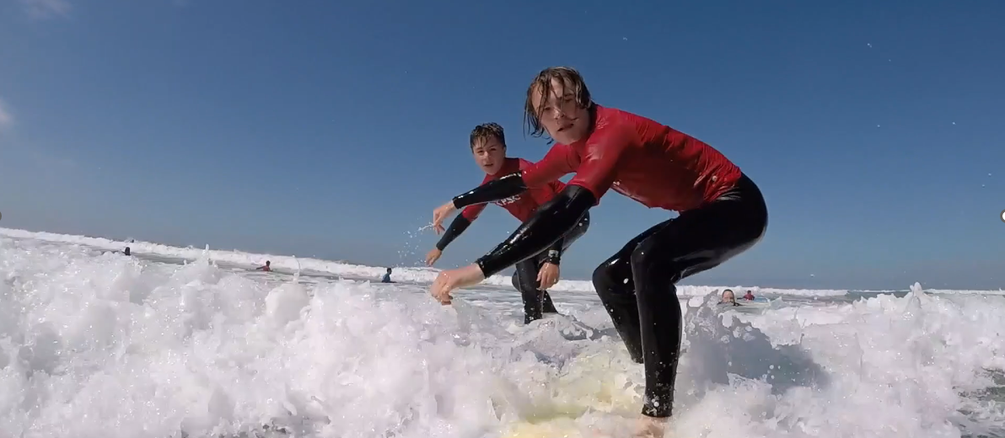
McClelland Academy Program
Engage with Industry Experts
Focus on Creating 21st Century Citizens
Student Led and Project Based
Focus on Employability Skills
Fostering Community Relationships

Slide 9
Onsite English Language Centre
Regular Contact Between School and Parents
Regular Home Visits
Homestay Matching
McClelland College
We match our homestay families with the needs and interests of our International Students
We also have an onsite English Language Centre to support students for VCE

Slide 10
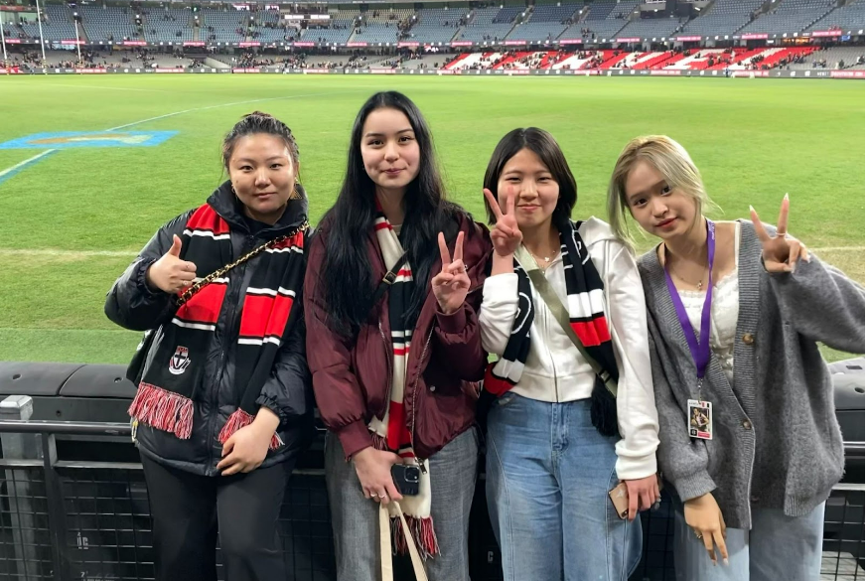
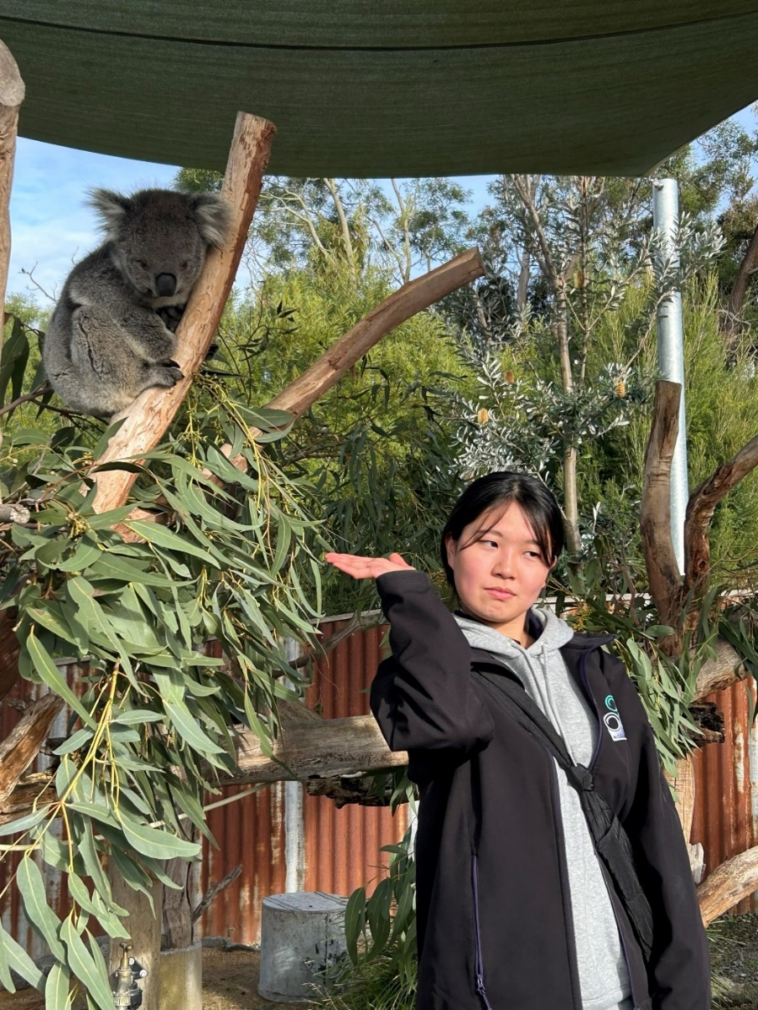
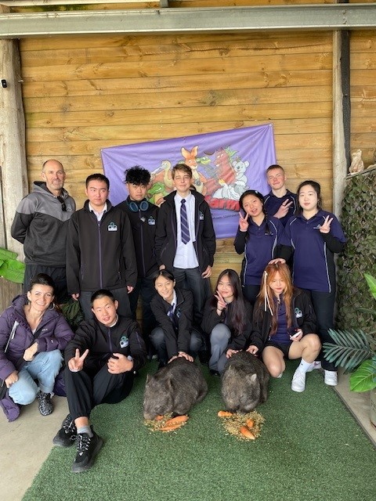
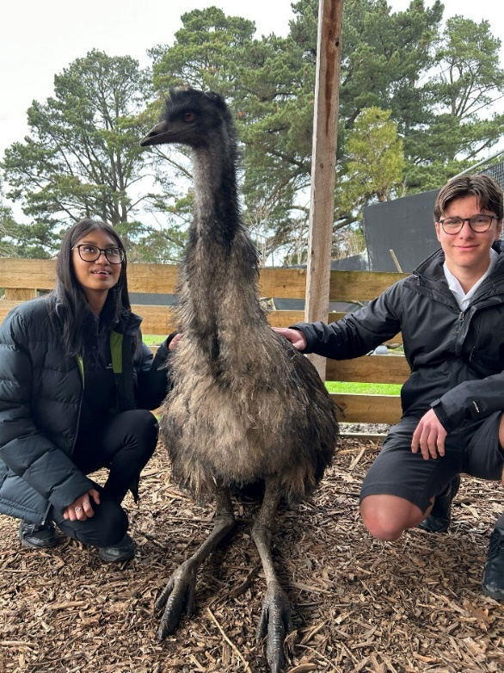
International Students in Our Community

Slide 11
CAMPS
1 FREE CAMP
Choose from:
Surf camp
Snow camp
Outdoor Ed camp
A wide range of camps are offered at McClelland College. This ranges from our privately owned SNOW CAMP at the foothills of Mt Buller, our SURF CAMP on the Great Ocean Road, through to our CENTRAL AUSTRALIA TOUR. With expert Outdoor Education staff we cover everything to do with the GREAT OUTDOORS!

Slide 12
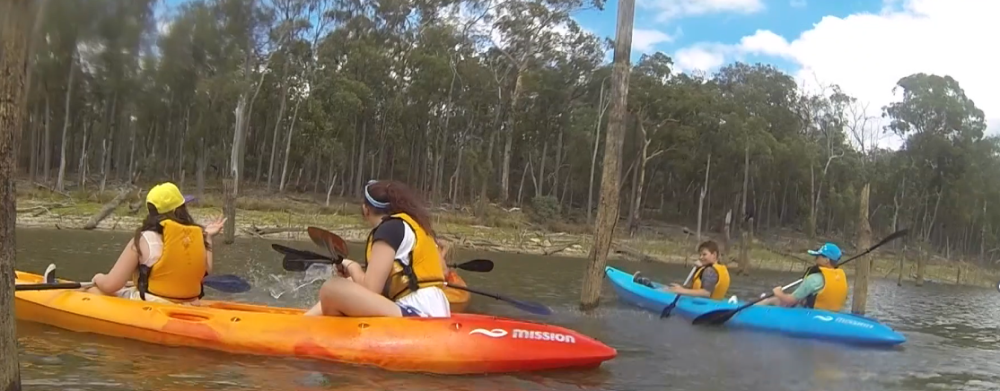
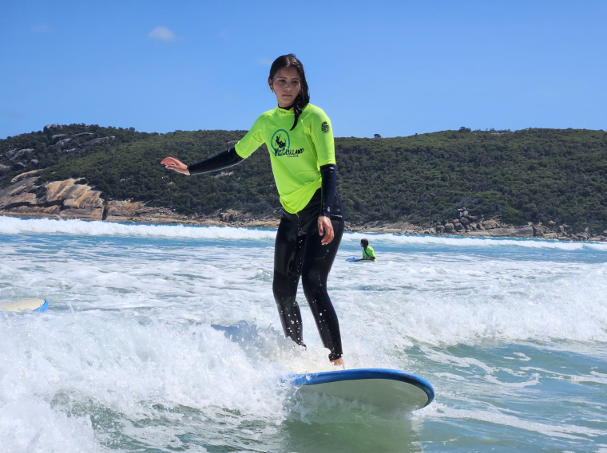
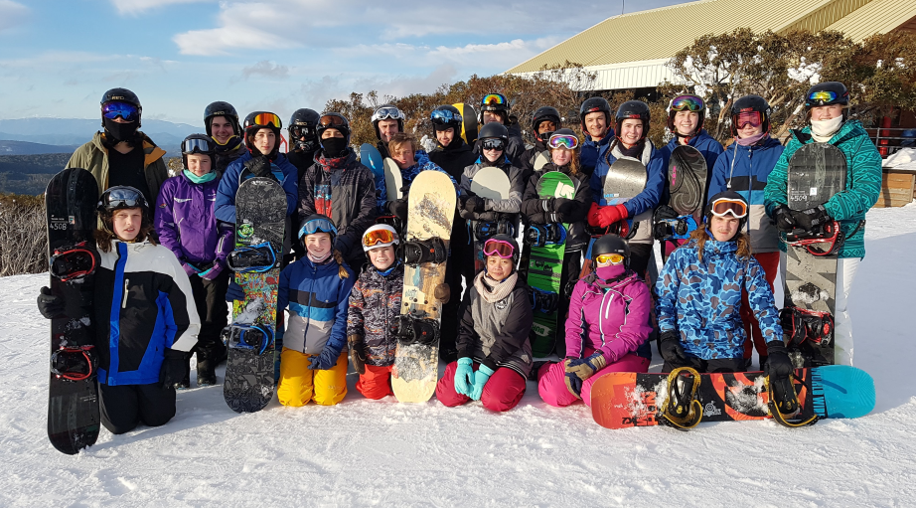
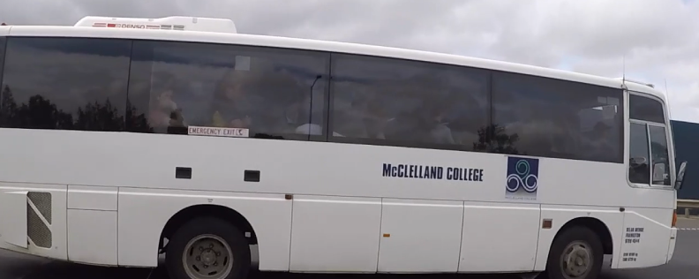
CAMPS

